Slide 1
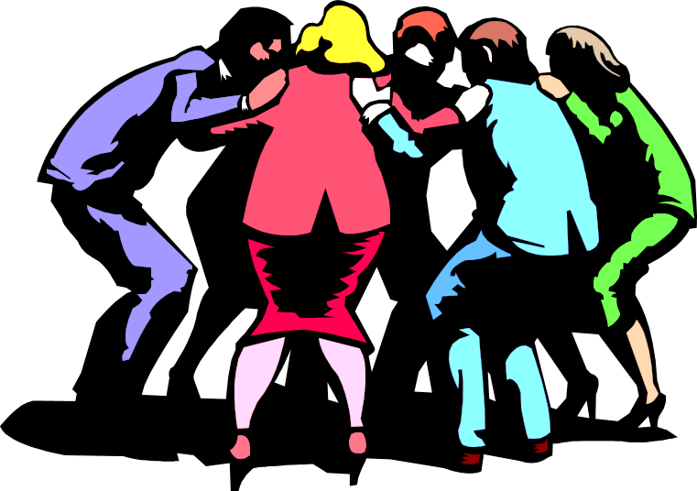
Managing work groups and teams
Presentation by
Saulė Stankevičiūtė, Džiugas Pečiulevičius & Mantas Podolskis.
PI18E

Slide 2

Group definition
Group – two or more people who interact regularly to accomplish a common purpose or goal.
Group types:
Functional or formal groups – work groups that have designated work assignments and tasks directed toward organizational goals.
Interest or informal groups – groups that are independently formed to meet the social needs of their members.
Task groups

Slide 3


Team definition
Team – an interdependent group of workers who function as a unit, often with little or no supervision, to carry out work- related task, functions, and activities.
Team types:
Self-managed teams – operates without a manager and is responsible for complete work process or segment.
Cross-functional teams – a work team composed of individuals from various specialties.
High performance / virtual teams – a type of work team that uses technology to link physically dispersed members in order to achieve a common goal.

Slide 4


Groups vs teams
Work Groups | Work teams
One leader is in charge | Leadership role is shared
Accountable only to self | Accountable to self and team
Focus on individual goals | Focus on team goals
Produce individual work products | Produce collective work products
Define individual roles, responsibilities and tasks | Define individual roles, responsibilities and tasks to help team do its work
Meetings to share information and perspectives | Frequent meetings for discussion, decision making, problem solving, and planning
Purpose, goals, approach to work shaped by manager | Purpose, goals, approach to work shaped by team leader with team members

Slide 5
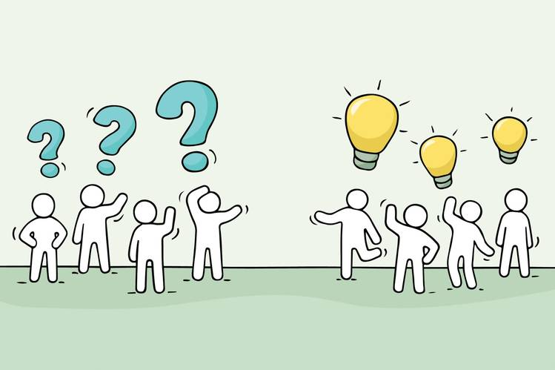

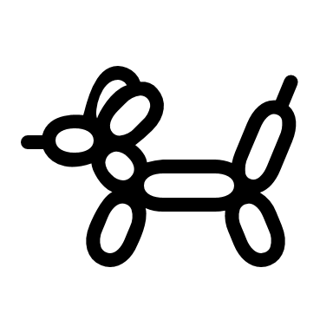
Roles
Role – a part an individual plays in helping the group reach its goals
Types:
Task-specific role (Leaders, gatherers)
Socioemotional role (Encouragers, compromisers)

Slide 6

Norms
Norms – the standards of what is right or wrong in a given social setting.
Reasons that groups enforce norms:
To facilitate the survival of the group
To simplify or clarify role expectations
To help group members avoid embarrassing situations
To express key group values and enhance the group’s unique identity
If you do not follow the rules and norms of the group, you naturally get

Slide 7
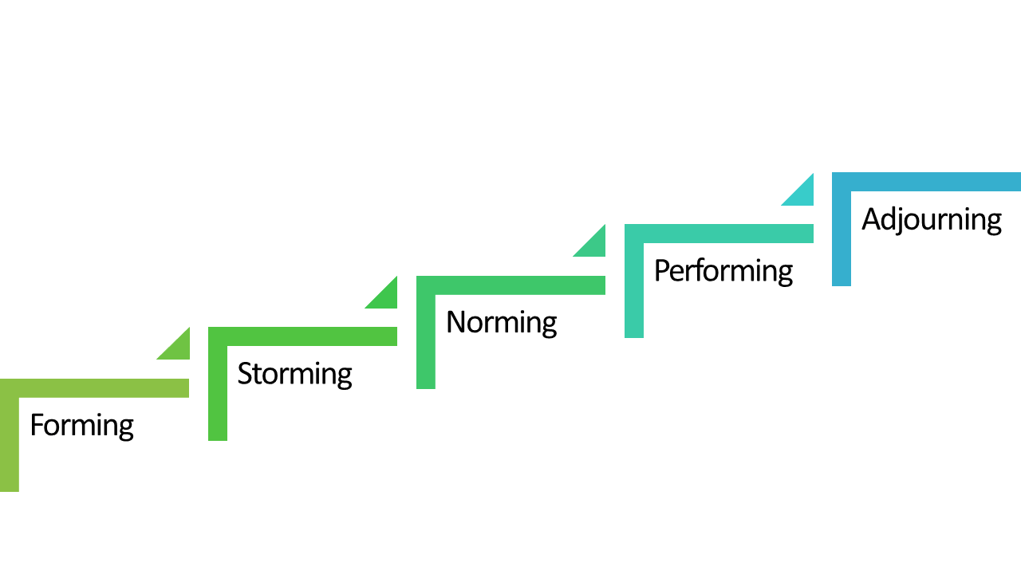
Group development stages

Slide 8


Forming – members join and begin the process of defining the group’s purpose, structure, and leadership.
Storming – Intragroup conflict occurs as individuals resist control by the group and disagree over leadership.
Norming – Close relationships develop as the group becomes cohesive and establishes its norms for acceptable behavior.
Performing - A fully functional group structure allows the group to focus on performing the task at hand.
Adjourning – The group prepares to disband and is no longer concerned with high levels of performance.

Slide 9

Cohesiveness of the group
Cohesiveness – the extent to which members are loyal and committed to the group; the degree of mutual attractiveness within the group.
Factors that increase cohesiveness | Factors that reduce cohesiveness
Intergroup competition | Group size
Personal attraction | Disagreement on goals
Favorable evaluation | Intragroup competition
Agreement on goals | Domination
Interaction | Unpleasant experiences

Slide 10




Formal leadership
Goals
Love and support for the leader
WoRkERs
Formal Leaders
Have been elected or designated to engage in leadership activities by the group members or have been formally appointed or recognized by the organization as the leader of the group.

Slide 11







Informal leadership
Informal Leaders
Engage in leadership activities but their right to do so is not formally recognized by the orgranization or group.
May also be formal leader for the group or may supplement formal leader in fulfilling leadership roles.
Draw on referent or expert power to establish themselves as leaders.

Slide 12














Conflict – a disagreement between two or more individuals, groups, teams or organizations.
Conflict
Conflict

Slide 13
Optimal level of conflict in an organization
Too little conflict and the organization becomes complacent and apathetic, lacking in innovation, underperforms.
Too much conflict creates a dysfunctional organization where hostility and non-cooperation predominate, and suffers from low performance.
A moderate level of conflict in an organization fosters motivation, creativity, innovation, and initiative and can raise performance.

Slide 14

Managing conflict
Types of conflicts:
Interpersonal conflict
Intergroup conflict
Conflict between an organization and its environment

Slide 15


Interpersonal conflict
Personality clash - A personality clash occurs when two (or more) people find themselves in conflict not over a particular issue or incident, but due to a fundamental incompatibility in their personalities, their approaches to things, or their style of life.
Differing beliefs or perceptions - conflict occurs due to the differences in beliefs and perceptions of workers.

Slide 16




Intergroup conflict
Group conflict, or hostilities between different groups, is a feature common to all forms of human social organization.
Although group conflict is one of the most complex phenomena studied by social scientists, the history of the human race evidences a series of group-level conflicts that have gained notoriety over the years.
bo
E
la
ded

Slide 17
















THANK YOU

